Slide 1

MALIGNANT COMMENT CLASSIFICATION
Malignant comment classification project :-
By Sharad Yadav
Guide-Mr.Keshav Bansal

Slide 2
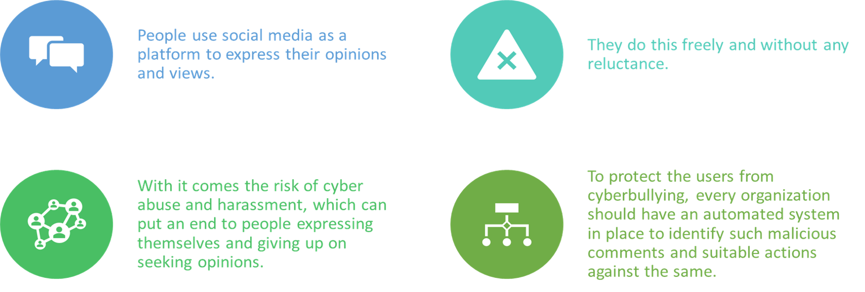


INTRODUCTION

Slide 3
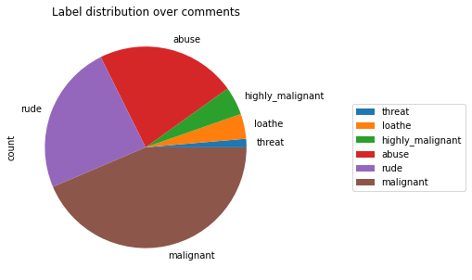
Objective
Our goal is to build a prototype of online hate and abuse comment classifier which can used to classify hate and offensive comments so that it can be controlled and restricted from spreading hatred and cyberbullying.

Slide 4

PREPROCESSING OF THE DATA
We have perform following pre-processing steps on dataset
1.Reading csv file
2. Removed punctuations
3. Applied counter vectorizer
4. Comment categorization
5. Remove stop words

Slide 5
DATA MODELLING
Problem Analysis and transformation method
I installed and used ntlk toolkit to process
text data stemming
I used Logistic regression,RandomForeset ,Decision
Tree classifier algorithm to classified all bad comments
The algorithm estimates the conditional probability of a particular word given a class as the relative frequency of term t in documents belonging to class

Slide 6
DATA VISUALIZATIONS

Slide 7
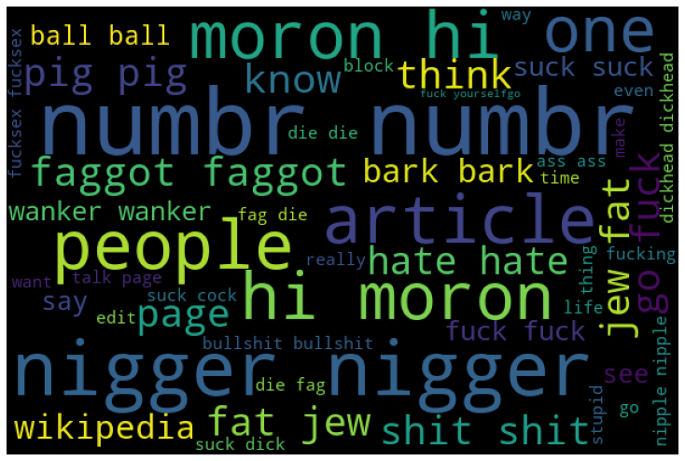
DATA VISUALIZATIONS

Slide 8
ANALYSIS OF RESULTS
Testing with different ML model , on the malignant tweets I have analyzed the following:
Most of the comments from social media are up to 1000 characters long.
Most of the comments from social media fell under the “Malignant”,”rude”, “buse”

Slide 9
CHALLENGES
All comments are object data type ,comments length and data size take too much time consuming to train model, difficult to extract insight of malignant comments.
Cleaning the data – Due to the character limit tweets contain a lot of short forms which are different to classify using bag of words model.

Slide 10
FUTURE SCOPE
The current project predicts the type or toxicity in the comment.
I am planning to add following features in the future work
1.Analyze which age group is being toxic towards a particular group comment malignant.
2.Add feature to automatically sensitize words which are classified as bad.
3.Handle mistakes and short forms of words to get better accuracy of the result.
Thank You

